Slide 1
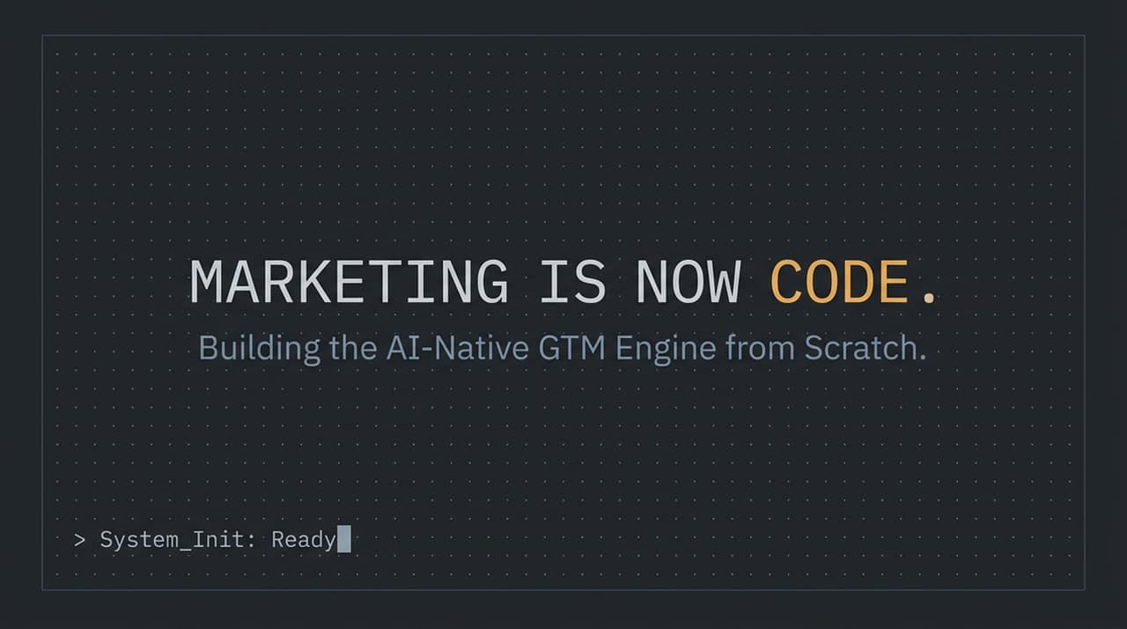
Notes:
Intro & Hook :
Welcome everyone. Today, we are breaking down a fundamental transformation in how Go-To-Market (GTM) and marketing teams operate.
The traditional marketing playbook—relying on manual execution, fragmented software stacks, and bloated headcount—is rapidly becoming obsolete.
Core Paradigm Shift :
Marketing is no longer just a creative or strategic function; marketing is now code.
Every modern workflow—whether it's generating ad creative, scraping social platforms, enriching lead lists, or running media campaigns—boils down to data, APIs, and execution loops.
If your team is still clicking through SaaS dashboards manually, you are running at a massive velocity disadvantage.
Session Purpose :
Over the next 16 slides, we will cover the infrastructure, operating system, and key outbound/inbound plays required to build an AI-native GTM engine from scratch.
How we’d build an AI-native marketing team from scratch | Eric Siu & Cody Schneider
https://www.youtube.com/watch?v=QKpRs-2EIiM

Slide 2
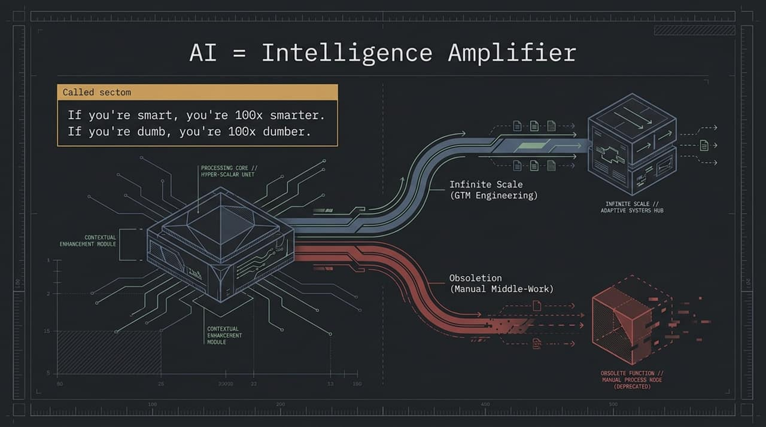
Notes:
Core Concept :
Let's start with a foundational truth: AI is an intelligence amplifier.
As the slide points out: If you're smart, you're 100x smarter. If you're dumb, you're 100x dumber.
Divergent Paths in GTM :
AI doesn't magically solve bad strategy or lack of domain knowledge. If you feed an AI agent vague instructions or flawed logic, it will generate high-volume slop at lightning speed, accelerating your path to failure (the Obsoletion curve).
However, when paired with high-context domain expertise and automated systems, AI acts as a hyper-scalar unit. It unlocks Infinite Scale, allowing a single marketer or small team to achieve the leverage of a massive department.
Key Takeaway :
The goal is not to use AI to automate bad habits, but to build contextual systems that amplify high-leverage marketing actions.

Slide 3
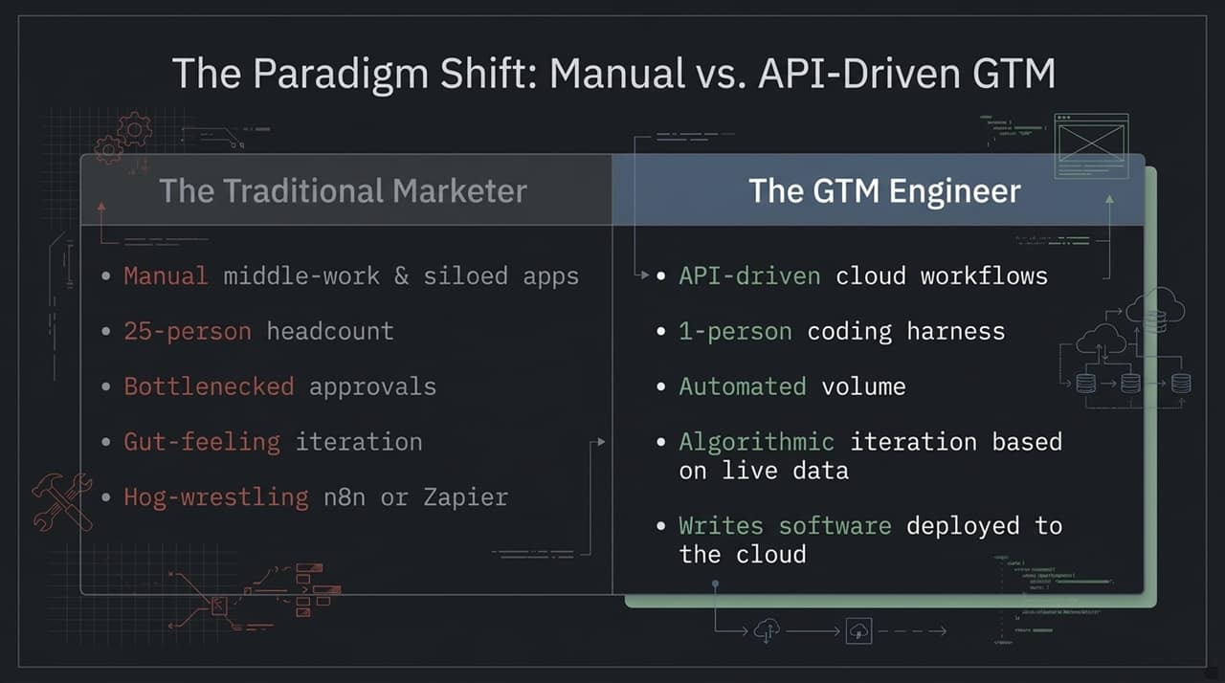
Notes:
Comparing the Old vs. New :
The Traditional Marketer: Relies on manual middle-work, siloed web apps, gut-feeling iteration, and convoluted hog-wrestled Zapier/n8n workflows that break constantly. Historically, achieving enterprise-scale execution required a 25-person team.
The GTM Engineer: Operates using API-driven cloud workflows and code. Instead of clicking buttons in SaaS UIs, they write software and scripts deployed directly to the cloud.
Leverage & Headcount :
A single GTM Engineer operating within a modern coding harness can achieve greater throughput and velocity than a traditional 25-person team.
Iteration is no longer driven by guesswork; it is algorithmic and powered by live data feedback loops.
Call to Action :
Marketers must transition from being manual operators to system architects who control the software running their marketing engine.

Slide 4
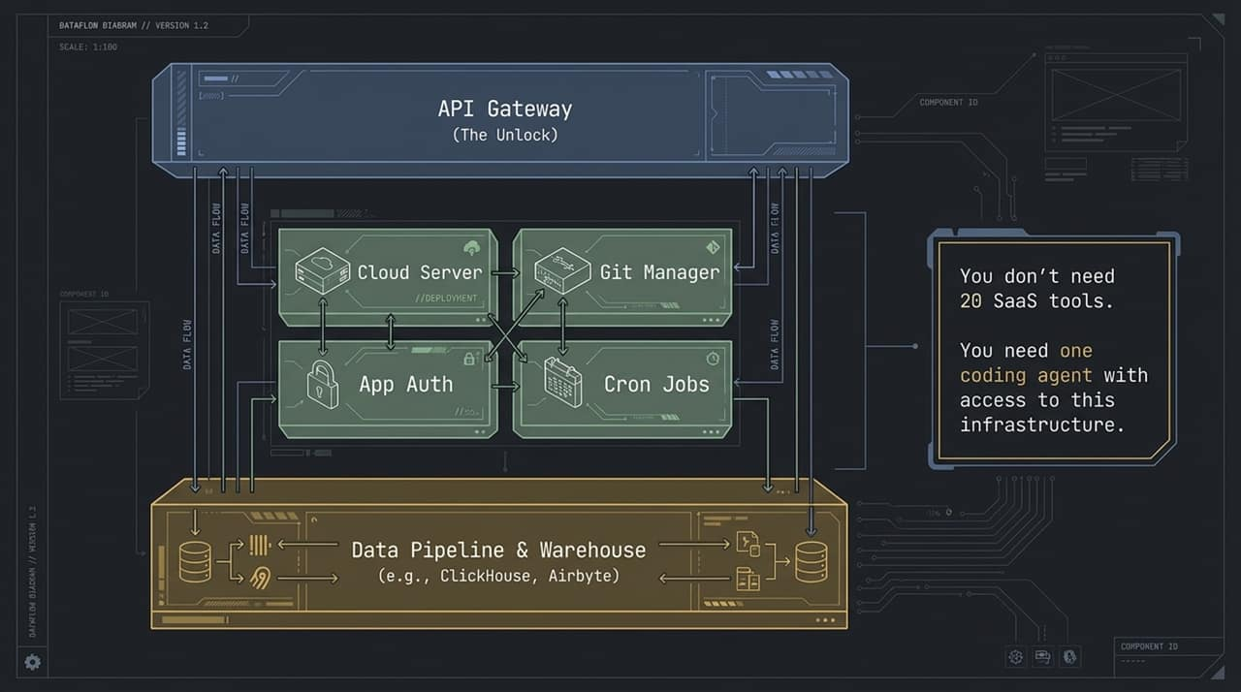
Notes:
Deconstructing the Infrastructure :
To run autonomous marketing workflows reliably, local scripts aren't enough—you need cloud infrastructure.
Let's walk through the core components shown in this dataflow diagram:
Data Pipeline & Warehouse (e.g., ClickHouse, Airbyte): Consolidates performance data across ad channels, payment processors, and CRMs.
Cloud Server & Cron Jobs: Executes recurring jobs (daily/hourly scripts) without human intervention.
Git Manager & Deployment: Ensures version control so multiple engineers/agents can collaborate safely.
API Gateway (The Master Key): Connects your coding agent directly to external tools, ad platforms, and scraping tools.
The One Coding Agent Concept :
You don't need 20 SaaS tools. You need one coding agent with access to this infrastructure.
Once an agent has programmatic access to your data warehouse and APIs, it can pull metrics, run SQL queries, make decisions, and execute actions end-to-end.
Wrap-Up :
Setting up this cloud environment is the foundational step toward freeing your team from manual middle-work.

Slide 5
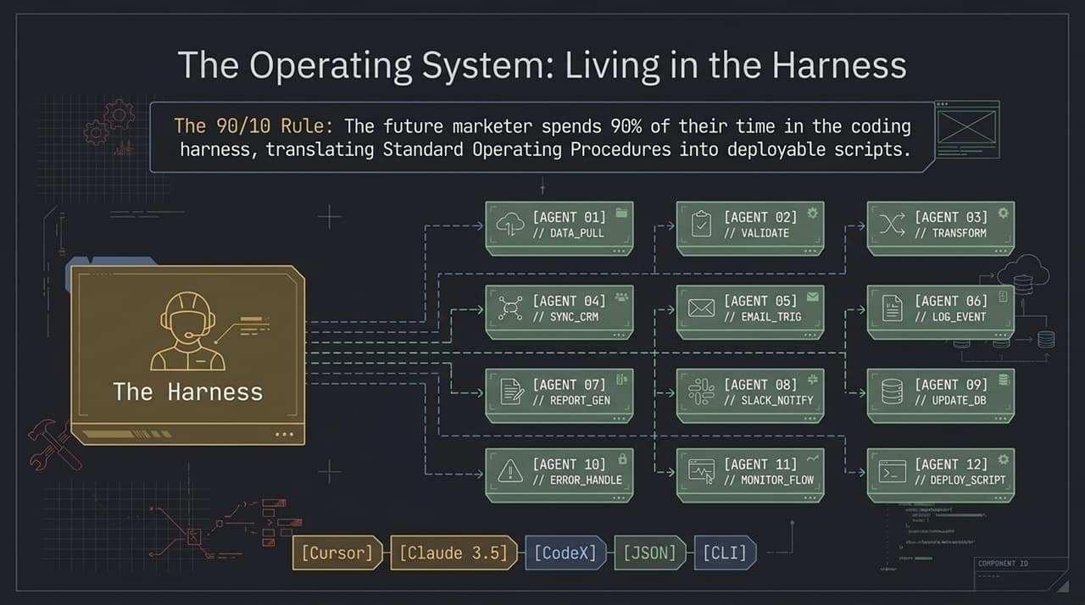
Notes:
The 90/10 Rule :
The modern marketer's primary workspace is changing. In the AI-native GTM model, marketers spend 90% of their time inside a coding harness (e.g., Cursor, Claude Code, CLI).
Their primary job is converting Standard Operating Procedures (SOPs) into deployable scripts.
How Agent Orchestration Works :
Inside the harness, you orchestrate specialized agent workflows sequentially or in parallel:
AGENT 01: Pulls raw data via API.
AGENT 02–03: Validates and transforms JSON schemas.
AGENT 04–06: Syncs to CRM, triggers personalized emails, and logs system events.
AGENT 07–12: Generates reports, notifies Slack, handles errors, and deploys scripts to production.
Shift in Daily Work :
Instead of performing the manual tasks yourself, you co-work with coding LLMs to build and refine the automated process, then deploy it to run continuously.

Slide 6
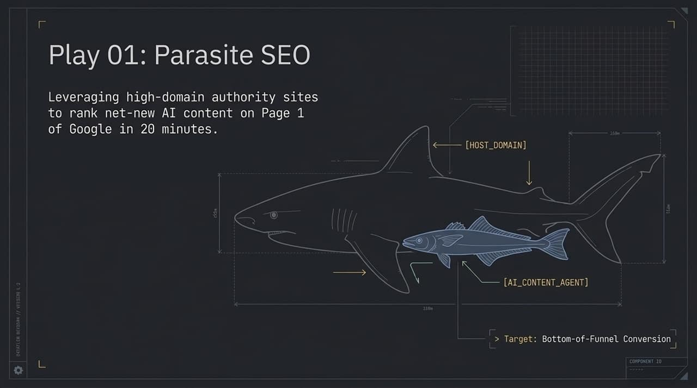
Notes:
Strategy Overview :
Parasite SEO involves leveraging high-domain-authority third-party platforms (like LinkedIn Pulse, Medium, or target publications) to rank net-new AI-generated content on Page 1 of Google rapidly.
Why This Matters Today :
Domain authority is extremely hard to build on a brand-new website. By publishing bottom-of-funnel conversion content on established host domains, Google trusts the site authority immediately.
Execution Velocity :
When executed correctly via AI pipelines, high-intent BOFU content can rank on Page 1 within 20 minutes to under an hour.
Objective :
Capture immediate, high-intent search traffic for competitive bottom-of-funnel keywords without waiting months for traditional domain SEO to mature.

Slide 7
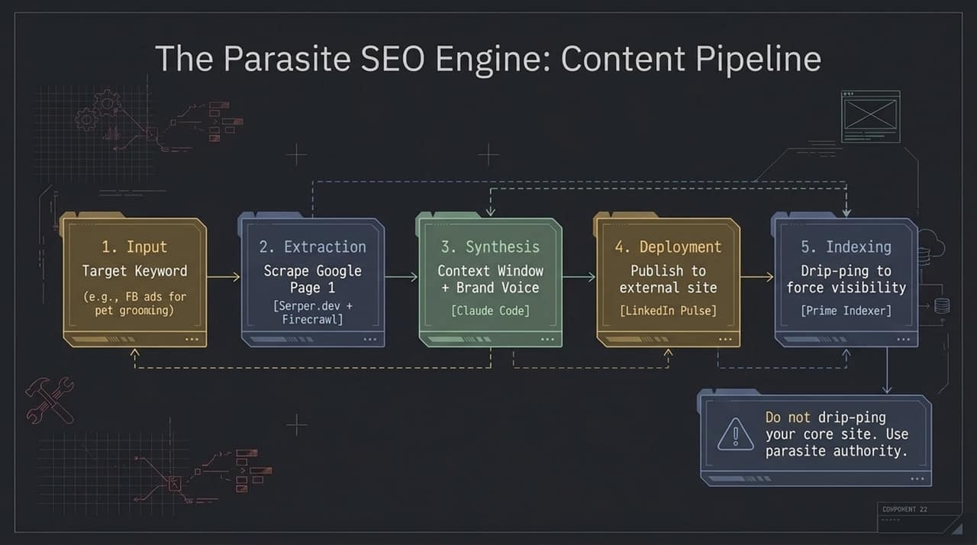
Notes:
Step-by-Step Architecture :
Input: Define high-intent target keywords (e.g., FB ads for kitchen remodeling or pet grooming).
Extraction: Scrape Page 1 Google results using tools like Serper.dev and Firecrawl. Google is already signaling what structure it wants to see.
Synthesis: Feed scraped search results and brand transcripts into LLMs (e.g., Claude) to craft optimized content matching search intent while preserving brand voice.
Deployment: Programmatically publish the synthesized article to a high-authority host site (e.g., LinkedIn Pulse).
Indexing: Use drip-pinging tools (e.g., Prime Indexer) to force Google crawlers to index the new URL immediately.
CRITICAL WARNING :
Do not drip-ping your core brand domain! Aggressive pinging techniques can trigger search engine penalties. Use this tactic strictly on high-authority parasite domains.

Slide 8
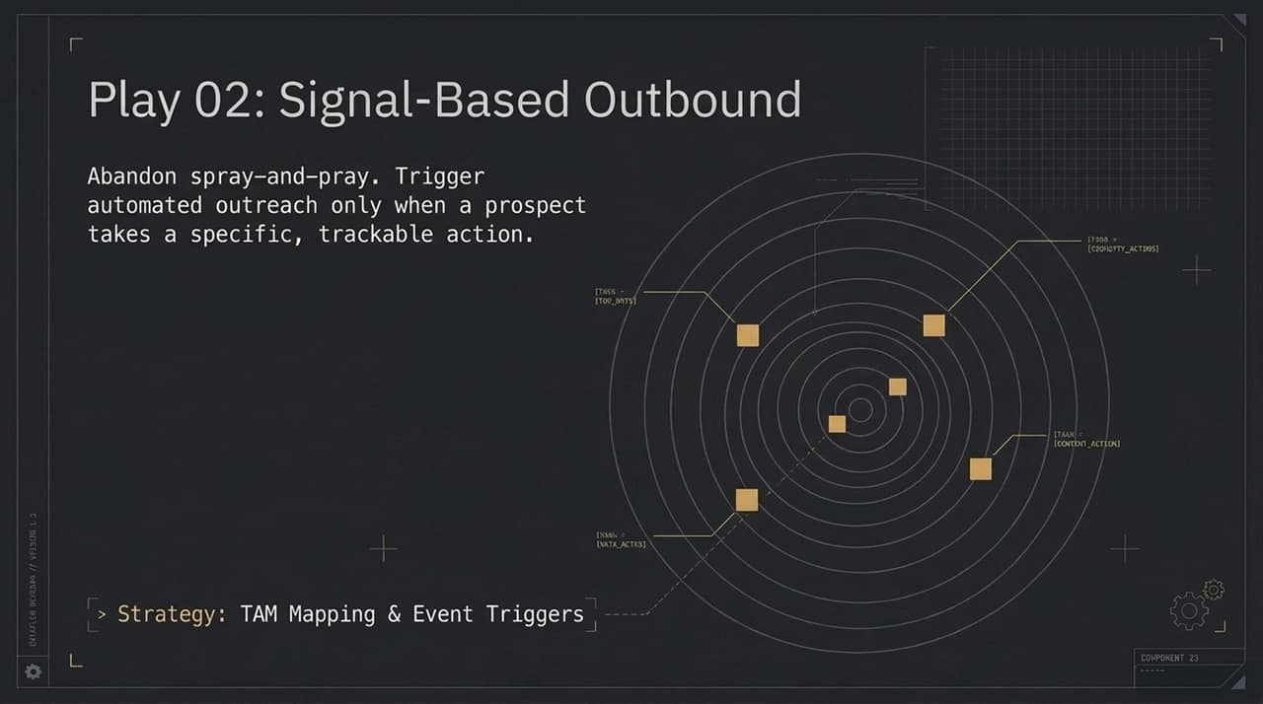
Notes:
Death of Spray-and-Pray :
Mass, unpersonalized cold email outreach is dead. Response rates are plummeting, domain deliverability is harder to maintain, and buyers ignore generic spam.
The modern approach is Signal-Based Outbound: triggering outreach only when a prospect demonstrates clear buying intent or takes a trackable action.
Mapping TAM and Event Triggers :
Step one is mapping your Total Addressable Market (TAM).
Step two is setting up automated event monitoring. Signals include job changes, engaging with competitor social posts, website visits, or tech stack updates.
Outcome :
Higher conversion rates and stronger relevance because your message arrives precisely when the prospect is in an active buying or research window.

Slide 9
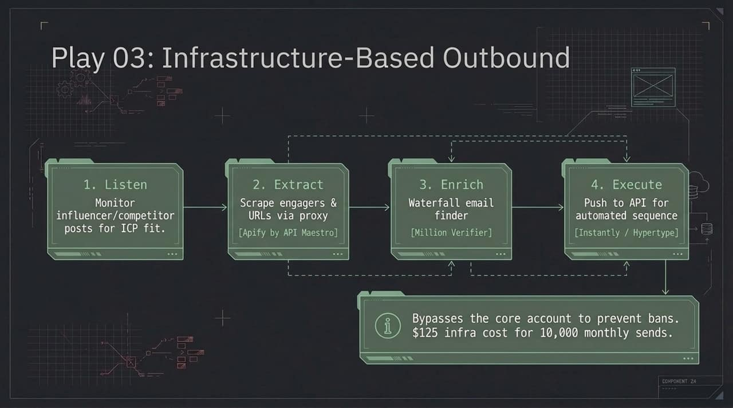
Notes:
Technical Outbound Workflow :
Listen: Continuously monitor competitor or influencer posts on platforms like LinkedIn/X for Ideal Customer Profile (ICP) engagement.
Extract: Scrape engagers and post URLs safely using proxy-managed scraping tools (e.g., Apify by API Maestro).
Enrich: Pass extracted profiles through a waterfall email enrichment engine (e.g., GetLeads, LeadMagic) and verify deliverables via Million Verifier.
Execute: Push verified contacts automatically via API into cold outreach platforms (e.g., Instantly or Hypertype).
Economics & Deliverability Protection :
Account Protection: Running scraping and outreach through proxy infrastructure and dedicated burner domains prevents your core company domain and primary LinkedIn accounts from being banned.
Unbeatable Unit Economics: Using isolated tenant infrastructure (like Hypertide/Inbox Kit) allows you to execute ~10,000 monthly sends for only $125 in infrastructure costs.

Slide 10
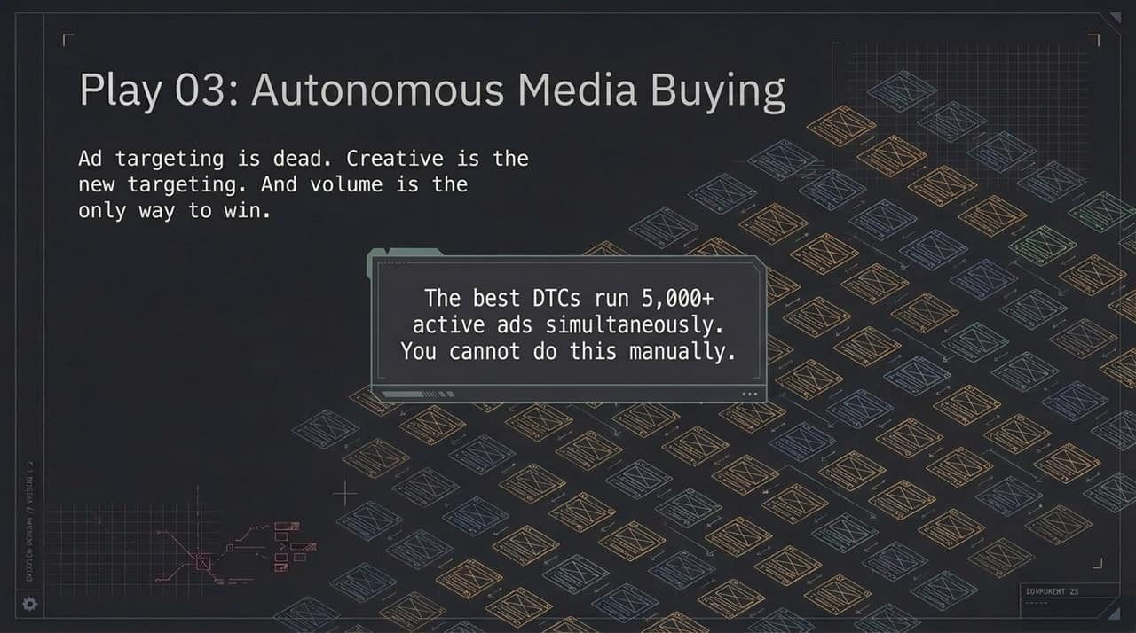
Notes:
The New Ad Paradigm :
Traditional ad targeting is dead—algorithms like Meta's Andromeda now handle audience distribution automatically based on ad creative content.
Creative IS the new targeting. The visual style, script, and messaging of the ad dictate who the platform shows it to.
Volume as the Competitive Moat :
The top-performing DTC brands and mobile apps run 5,000+ active ads simultaneously.
Humans cannot manually design, edit, write, and launch thousands of ads per month. High volume requires programmatic creative generation engines.

Slide 11
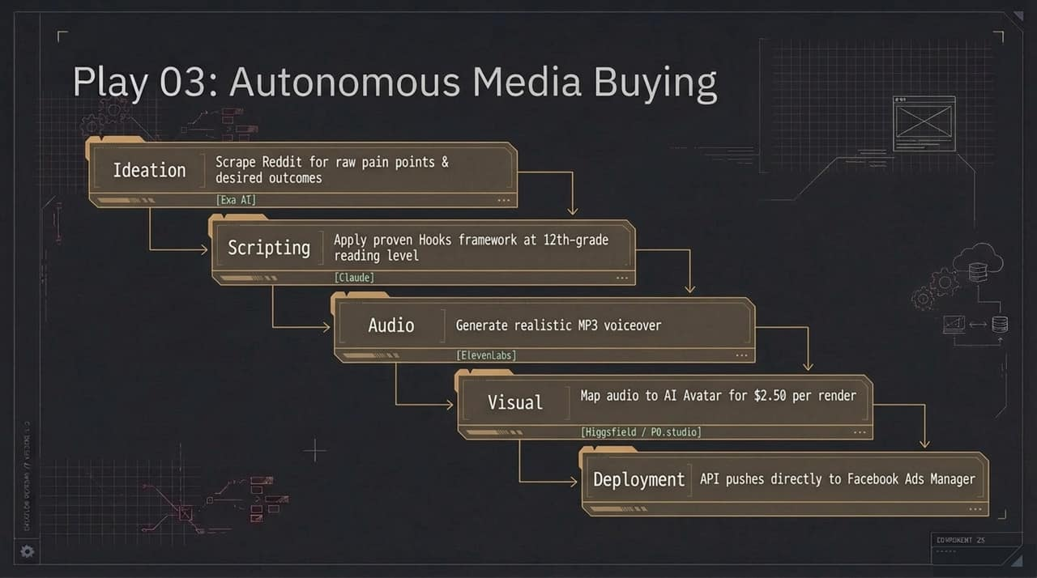
Notes:
Step-by-Step Creative Stack :
Ideation: Scrape Reddit, forums, and reviews via Exa AI to uncover authentic customer pain points and desired outcomes.
Scripting: Feed raw research into Claude/LLMs using structured hook frameworks designed for high engagement.
Audio: Pass scripts into ElevenLabs to generate ultra-realistic voiceovers.
Visuals: Map the audio track to photorealistic AI Avatars (using tools like Higgsfield or P0.studio) for as low as $2.50 per video render.
Deployment: Push finished ad assets and copy directly into Facebook Ads Manager via API.
Key Takeaway :
This entire pipeline converts unstructured market research into fully deployed video ad campaigns without filming a single piece of raw footage.

Slide 12
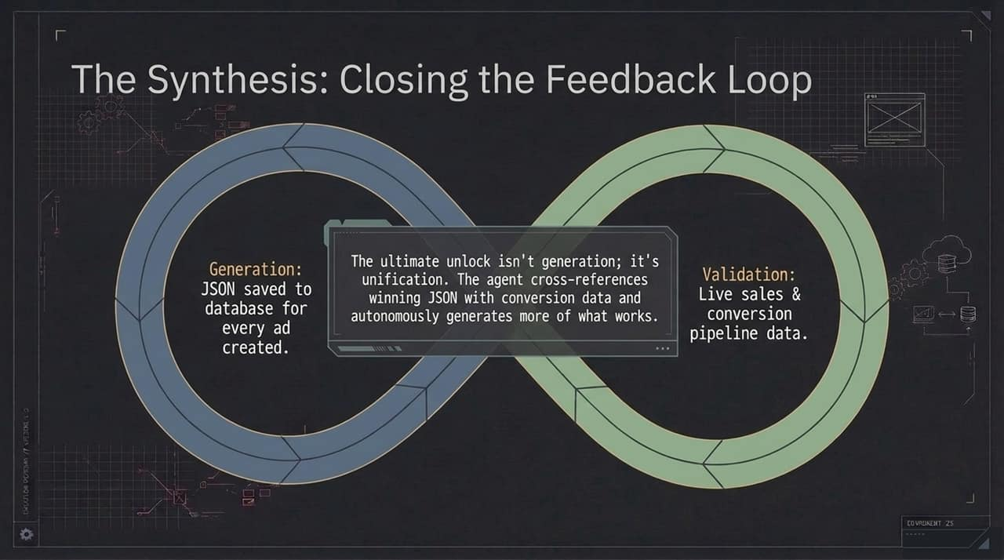
Notes:
Generation vs. Unification :
Generating thousands of ads is impressive, but generation alone is useless if you don't know what works.
The ultimate unlock is Unification—connecting creative generation directly to real-time sales performance data.
Data Loop Mechanism :
Generation: Every generated ad's metadata (script, hook type, avatar used, visual style) is saved as structured JSON in the database.
Validation: Live conversion and pipeline data flow back into the data warehouse from CRMs and payment processors.
Autonomous Iteration: AI agents cross-reference winning JSON configurations with high-converting ads, autonomously generating new iterations of what is actively driving revenue.

Slide 13
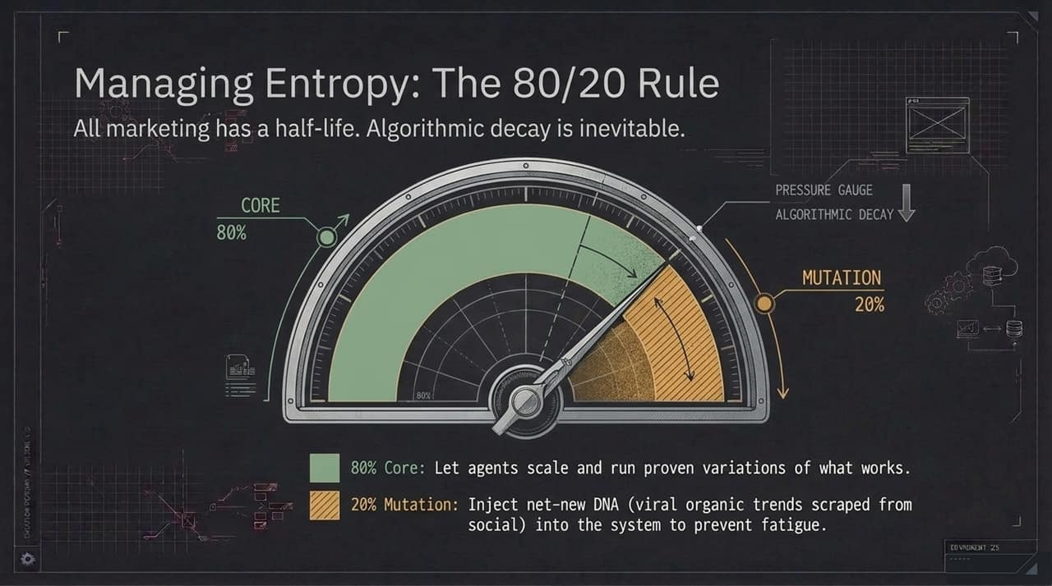
Notes:
Understanding Algorithmic Decay :
All ad creative and marketing plays suffer from fatigue. Audiences get bored, performance decays, and cost-per-acquisition (CPA) rises over time.
To combat decay, systems must manage entropy using an 80/20 balance:
The 80/20 Framework :
80% Core: AI agents continuously run and scale proven variations of high-performing, validated ad concepts.
20% Mutation: Inject net-new creative DNA into the engine by constantly scraping trending viral organic social trends and testing radical new hooks.
Takeaway :
The 20% mutation budget prevents creative fatigue and continuously discovers your next major winning baseline.

Slide 14
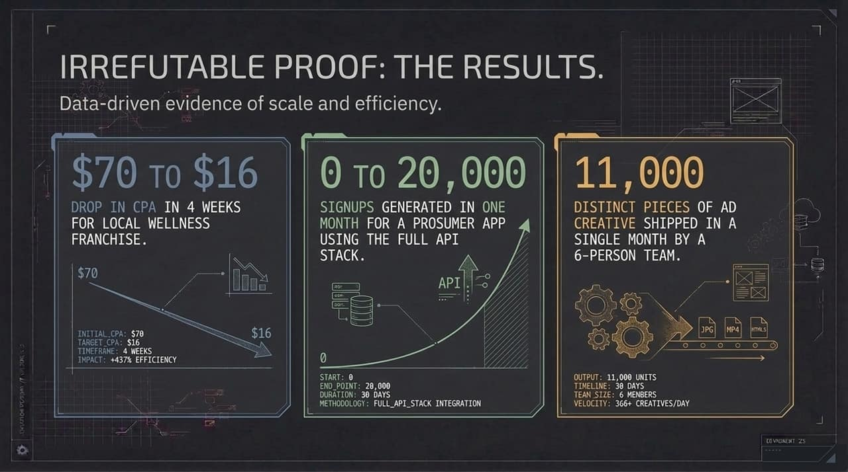
Notes:
Real-World Case Studies & Performance Data :
Metric 1: Local Wellness Franchise (CPA Reduction)
CPA dropped from $70 down to $16 in just 4 weeks (+437% efficiency gain) by running automated, high-velocity creative testing.
Metric 2: Prosumer Mobile App (Growth Scale)
Scaled from 0 to 20,000 signups in 30 days using the full API-driven stack across paid ads, cold email, and SEO.
Metric 3: High-Velocity Creative Output
A lean 6-person team shipped 11,000 distinct pieces of ad creative in a single month (over 366 creatives per day).
Summary :
These results prove that API-first GTM operations aren't theoretical—they deliver radical efficiency and volume advantages today.

Slide 15
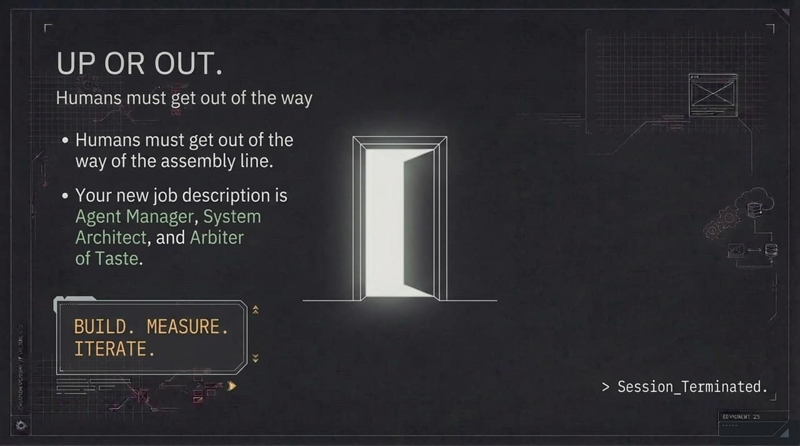
Notes:
The New Mindset :
Humans must step out of the manual assembly line. If your day consists of copying data between spreadsheets, resizing images, or manually uploading ads, your job is at risk.
You must elevate your skillset: Up or Out.
The 3 New Job Descriptions :
Agent Manager: Directing, monitoring, and delegating tasks to autonomous agent workflows.
System Architect: Designing the data pipelines, SOPs, and API connections that power the marketing engine.
Arbiter of Taste: Setting high brand quality bars, evaluating creative outputs, and applying domain judgment where models fall short.
Closing Mantra :
Build. Measure. Iterate.

Slide 16
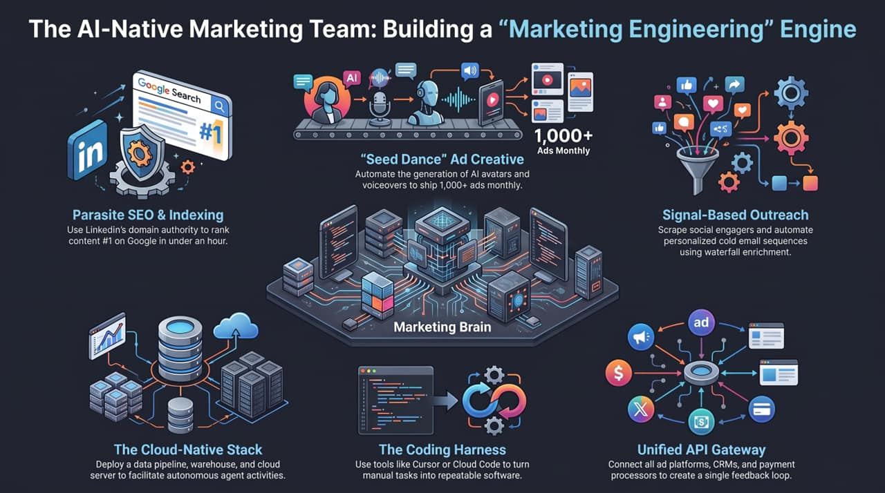
Notes:
Full-System Recap :
To conclude, let's look at the unified blueprint of the AI-Native GTM Engine:
The Coding Harness & Cloud Stack: The core foundation where scripts turn manual SOPs into software connected to cloud databases and warehouses.
Unified API Gateway: Unifies paid ad channels, CRMs, scrapers, and indexers into a single system.
Execution Nodes:
1,000+ Ads Monthly: Automated AI avatars and voiceovers shipping creative at scale.
Parasite SEO: Rapid Page 1 ranking within an hour via authority domains.
Signal-Based Outreach: Scraping social engagers and executing waterfall-enriched cold outreach.
Final Q&A Transition :
Building this engine isn't about replacing human creativity—it's about removing operational friction so small teams can compete with enterprise budgets.
Let's open the floor to questions and discuss how you can begin implementing these workflows in your business today.
How we’d build an AI-native marketing team from scratch | Eric Siu & Cody Schneider
https://www.youtube.com/watch?v=QKpRs-2EIiM

